Slide 1

CS361: Computer Architecture
Instruction-level Parallelism..
RISC Architecture
Advanced ILP
Book Computer Architecture: A Quantitative Approach, Sixth Edition, Section C.1 – C2 3.1,.3.2,3.3
CS324 Computer Architecture 1

Slide 2
RISC PIPELINE
Instruction Cycles of Three Segment Pipeline
Load and Store Instructions
I: Instruction Fetch
A: Decode, Evaluate Effective Address
E: Register-to-Memory or Memory-to-Register
Data Manipulation Instructions
I: Instruction Fetch
A: Decode, Read Registers, ALU Operations E: Write a Register
Program Control Instructions
I: Instruction Fetch
A: Decode, Evaluate Branch Address E: Write Register(PC)
RICS pipelining benefits from complier based handling of hazards, such as
delayed load and delayed branch.

Slide 3
DATA HAZARDS IN A RISC PIPELINE
LOAD: LOAD:
R1 ← M[address 1] R2 ← M[address 2]
ADD: R3 ← R1 + R2
STORE: M[address 3] ← R3
Three-segment pipeline timing
Pipeline timing with data conflict
clock cycle Load R1 Load R2
Add R1(+R2)
Store R3
1 2 3 4 5 6
I A E
I: Fetch and Instruction
A: Decode, Read registers, ALU Operation
E: Execute (write a reg, reg to mem, or mem to reg)
I A E
I A E
I A E

Slide 4
BRANCH HAZARD ARE HANDLED THROUGH DELAYED
BRANCH
Pipeline timing with delayed load
clock cycle Load R1 Load R2 NOP (stall) Add R1(+R2)
Store R3
1 2 3 4 5 6 7
I A E
I A E
I A E
I A E
I A E
If the compiler cannot find a useful instruction to put after the load, it inserts a no- operation instruction (this is a type of instruction that has no operation or outcome, thus wasting a clock cycle). This concept of delaying the use of the data loaded from memory is referred to as delayed load.

Slide 5
BRANCH HAZARD ARE HANDLED THROUGH DELAYED
BRANCH
Compiler analyzes the instructions before and after
the branch and rearranges the program sequence by
inserting useful (non-conflicting) instructions in the delay steps
Using no-operation instructions
Clock cycles: | 1 | 2 | 3 | 4 | 5 | 6 | 7 | 8 | 9 | 10
1. Load | I | A | E
2. Increment |  | I | A | E
3. Add |  |  | I | A | E
4. Subtract |  |  |  | I | A | E
5. Branch to X |  |  |  |  | I | A | E
6. NOP |  |  |  |  |  | I | A | E
7. NOP |  |  |  |  |  |  | I | A | E
8. Instr. in X |  |  |  |  |  |  |  | I | A | E
Rearranging the instructions in the pipeline instead of having NOP instructions or stalls
Clock cycles: | 1 | 2 | 3 | 4 | 5 | 6 | 7 | 8
1. Load | I | A | E
2. Increment |  | I | A | E
3. Branch to X |  |  | I | A | E
4. Add |  |  |  | I | A | E
5. Subtract |  |  |  |  | I | A | E
6. Instr. in X |  |  |  |  |  | I | A | E

Slide 6
A clarity… NOP vs Bubble
What is a NOP Instruction?
NOP = No Operation
A real instruction that performs no work
Occupies the pipeline for one cycle
Used by compilers to create delays
Appears in machine code and assembly
Moves through all stages (IF → ID → EX → MEM → WB)
What is a Pipeline Stall?
A stall is when hardware pauses the pipeline
No new instruction enters the next stage
Hardware freezes PC & IF/ID register
Injects a bubble (empty operation) into the pipeline
Bubble acts like NOP but is NOT a real instruction

Slide 7
ADVANCED ILP
Pipelining exploits the potential parallelism among instructions. This parallelism is called instruction-level parallelism (ILP).
Advanced ILP is a primary method for increasing the potential amount of instruction-level parallelism:
Advanced ILP is achieved by Multiple Issue.
Multiple Issue: A scheme whereby multiple instructions are launched in one clock cycle.
If one pipeline is good then two pipelines are better.

Slide 8
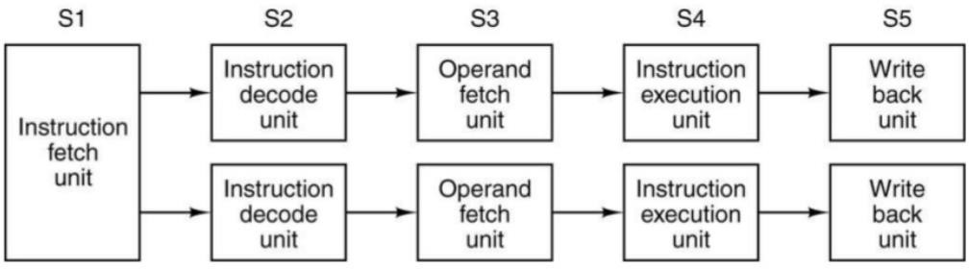
MULTIPLE-ISSUE PIPELINING
Dual five-segment pipelines with a common instruction fetch unit
Single instruction fetch unit fetches pairs of instructions together and puts each one into its own pipeline, complete with its own ALU for parallel operation (dual ILP)
A dual five-segment pipeline (2-way multiple issue) processor can have 10 instructions in execution at any given time.

Slide 9
HOW TO PERFORM MULTIPLE ISSUE?
Replicate the internal components (functional units) of the CPU so that it can launch multiple instructions in every pipeline stage in one clock cycle.
Today’s high-end microprocessors attempt to issue from
three to six instructions in every clock cycle.
The metric has flipped from CPI to IPC (Instructions per clock cycle)
Two ways to implement Multiple Issue
Static
Dynamic

Slide 10
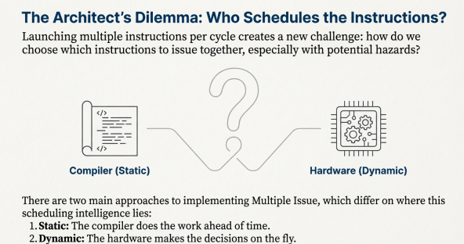

Slide 11
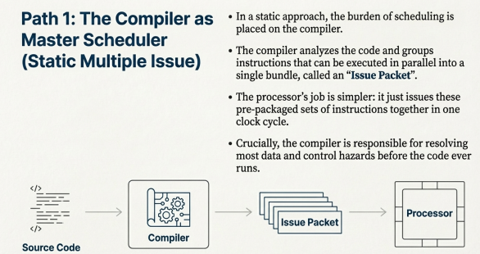

Slide 12
STATIC MULTIPLE ISSUE
Issues a set of instructions, called “Issue Packet”, together
in one clock cycle.
Compiler decides the “Issue packet” and resolves most hazards.

Slide 13
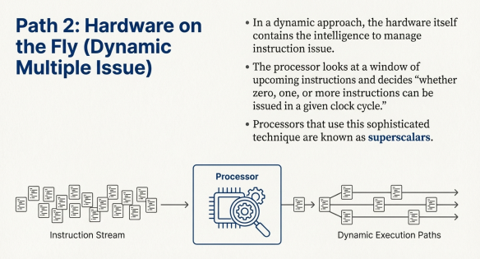

Slide 14
DYNAMIC MULTIPLE ISSUE
Processor decides whether zero, one, or more instructions can be issued in a given clock cycle.
Dynamic multiple issue processors are also known as
superscalars.
– Superscalars use dynamic pipelining that enables the processor to execute more than one instruction per clock cycle by selecting them during execution.
Hazards are handled through complier as well as hardware.
Hardware support for reordering the order of instruction execution so as to avoid stalls is called “dynamic pipeline scheduling”.

Slide 15
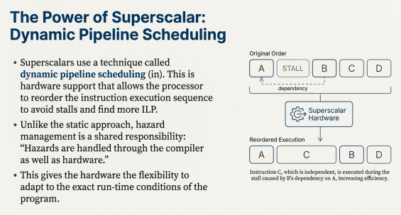

Slide 16
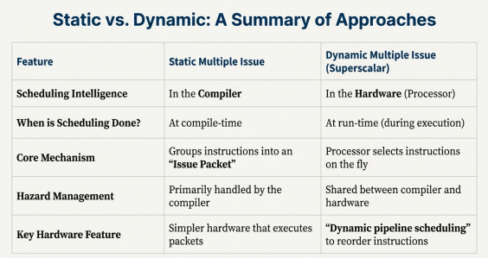

Slide 17
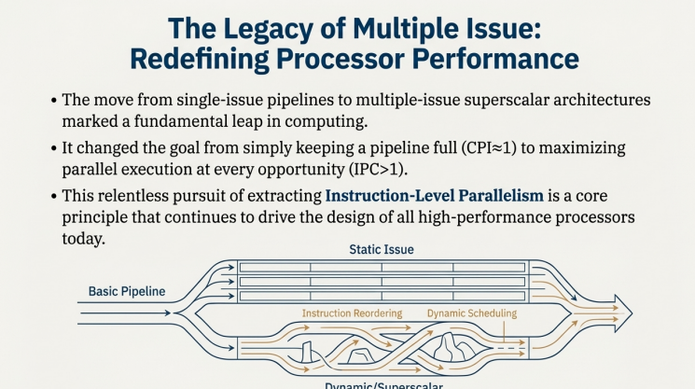

Slide 18


Slide 19


Slide 20
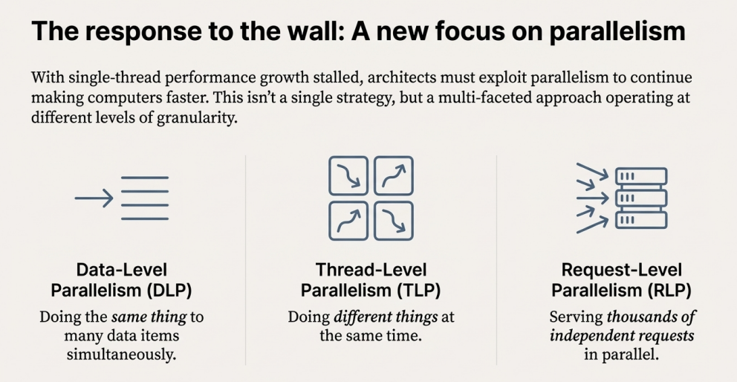

Slide 21


Slide 22







CPU TIME
– Consider 64 Basic Computer ADD instructions with 3 ns clock cycle time
T0: AR ← PC
T1: IR ← M[AR], PC ← PC+1
T2: Decode
IR(12-14),
AR←IR(0-11),
I ← IR(15)
T3: no operation T₄: DR ← M[AR] T₅:AC ← AC+DR,
because direct addressing is used
SC ← 0
CPU time = number of instructions x CPI x clock cycle time
= 64 x 6 x 3 ns
= 1152 ns
What speedup can be achieved by a SISD pipelined processor
having 3 segments?

Slide 23
FLYNN’S TAXONOMY
Single instruction stream, single data stream (SISD)
Conventional uniprocessor with sequential instruction execution
Parallel processing may be achieved by means of pipelining instruction (Instruction level parallelism)
Single instruction stream, multiple data streams (SIMD)
We will see that SIMD leads to Data level Parallelism (DLP)
Data-level parallelism: Spreading data across multiple memories for parallel read and write operations.
DLP arises because there are multiple data items that can be
operated on simultaneously, for instance in a “loop”.
Multiple instruction streams, single data stream (MISD)
Multiple instruction streams, multiple data streams (MIMD)

Slide 24
SIMD ARCHITECTURE
SIMD computers operate on arrays of data.
For example when dealing with arrays in loops of identically structured data.
A SIMD architecture includes replicated processing units, called processing elements (PEs), which operate in parallel under the supervision of a common control unit.
Each PE has its own data memory (hence the MD in SIMD), but there is a single instruction memory and control unit, which fetches and dispatches instructions.
A single instruction is applied to many data streams.
PEs receive the same instruction from the control unit but operate on different items of data.

Slide 25
SIMD ARCHITECTURE
– Considering our current example, a single SIMD instruction adds 64 numbers by sending 64 data streams to 64 PEs to form 64 sums within a single clock cycle.
SIMD computers exploit data-level parallelism by applying the same operations to multiple items of data in parallel.
Capable of executing a loop in one clock cycle.
Types of SIMD computers
Array Processors
Vector Processor: Vector architectures and Graphic Processor Units (GPUs) exploit data-level parallelism by applying a single instruction to a collection of data in parallel.

Slide 26
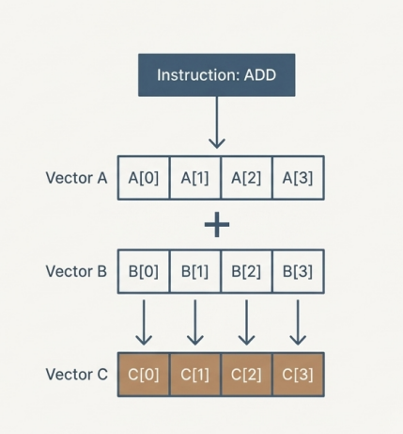
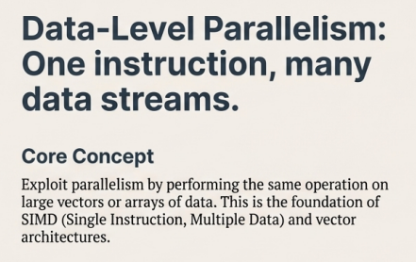

Slide 27
SIMD ARRAY PROCESSORS
Array processors perform computations on large arrays of data of complex scientific applications
SIMD array processor is a computer with multiple processing elements (PEs) operating in parallel under a common control unit.

Slide 28
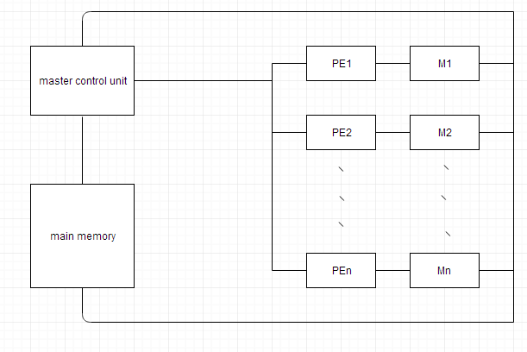
SIMD ARRAY PROCESSOR ORGANIZATION
Contains a set of identical processing elements (PEs)
Each PE includes an ALU, working registers and has a local memory M
The master control unit controls the operations in the PEs
– Master control unit fetches and decodes instructions from the main memory

Slide 29
SIMD ARRAY PROCESSOR ORGANIZATION
Non-array type and program control instructions are executed within the master CU
An instruction involving array is sent to all PEs simultaneously and local
memories are populated with the array operands
Each PE uses operands stored in its local memory to execute the instruction
in one clock cycle.

Slide 30
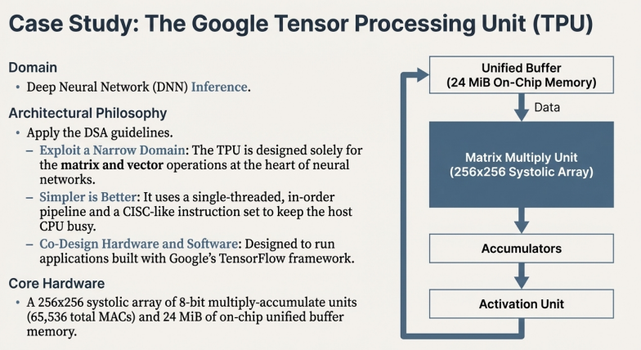

Slide 31
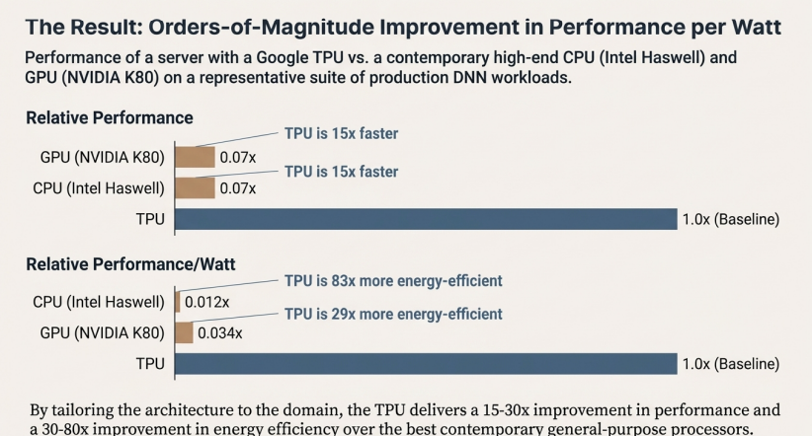

Slide 32


Slide 33
